Slide 1

STRENGHTENING OUR HOUSING INSTITUTIONS
BUILDING THE FOUNDATION FOR SUSTAINABLE GROWTH
FEMI ADEWOLE, UEI, 2023

Slide 2


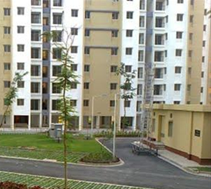
A frightening context………
During the course of this presentation…….
350 families would have migrated to one of the major cities in Nigeria in search of a new life.
By 2050, about 200million Nigerians will be living in our cities catalysing unprecedent explosion of these places. Cities like Lagos and Kano will be home to over 35million people.
Single minded large scale housebuilding programme is required to prevent catastrophic consequences. Previous Governments appear to have recognized and planned for this.

Slide 3

……key message
More Nigerians (in % terms) now lack access to a decent affordable housing than 40 years ago because we are not building enough housing.
Multiple interventions over the last 40 years have been inadequate due to a multiplicity of factors with weak institutional capacity along the value chain being one of them.

Slide 4

……..results are below expectation
In spite of ambitious housing targets since the first plans in 1962, execution has consistently fallen short;
On average only about 10% of stated targets are achieved with 23% on the 1980-85 Plan being the highest;

Slide 5

……..square wheels
On the whole plans have been well intentioned and well developed.
Execution is where we have been lacking. There is general acceptance that issues like inadequate financing, land administration have undermined execution capability.
However, there has been inadequate focus on a very week value chain particularly the capacity of key players including: Publicly Owned Agencies, PMBs, Developers etc.

Slide 6

…..why strong institutions ?
Effective Institutions are at the heart of execution. Culture eats Strategy for breakfast.
Strong Institutions can make something of imperfect strategy, but the reverse is not the case.
They have ability to mobilise resources.
They can attract the best talents
They can influence policy. Policy makers listen to them because they are perceived as critical to society and the economy.
They can deliver.

Slide 7
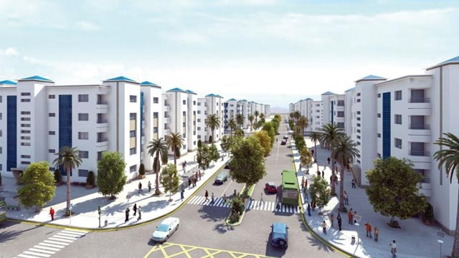
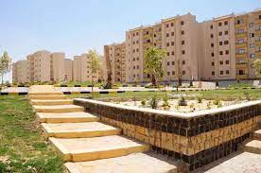
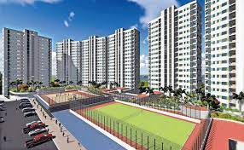
…..some examples
MOROCCO - AL OUMRANE
EGYPT – SHA
TANZANIA - NHC

Slide 8


Slide 9
Review Establishment Instruments
With respect to the key Publicly Owned Housing Institutions (FMBN, FHA, FHFL, Housing Corps) and NMRC, the establishing instruments and articles should be reviewed to remove existing barriers to change.
For instance, FMBN, FHA and Housing Corporations should be allowed to access the capital market once they have the capacity to do so. This includes issuing bonds, promoting alternative vehicles like REITS.
One of the largest consulting firms in the world today is Surbana Jurong working in many African, Asia, Latin American countries on large projects. Surbana Jurong was originally the in-house technical team of HDB – The Singaporean Housing Development Board. SMEC has annual turnover of US$2bn.
Investment in Housing Related activities including MMC Factories etc.

Slide 10

Corporate Governance
Need to enhance Corporate Governance – Independence, Skills and accountability.
Leadership
Ensure that clear frameworks for identifying and managing risk exists
Transparency.

Slide 11
Capitalisation
Almost all of the key players in the housing value chain are undercapitalized.
Capital Requirement is N2bn – N5bn(USD2m – USD5m). This is grossly inadequate to support the scale of mortgage financing required. Most Housing Corporations have negative capital and the vast majority of private sector developers have no meaningful equity to support development at scale. For relativity, HFDC of India has a capitalization of US54bn
Options for improving capital base include:
  Providing Incentive (e.g. Tax Waivers) on private investments in PMBs, Development Companies
  Additional Public Investment in FMBN/FHA/NMRC
  Partial Guarantees for PF/PE Investments in PMBs
  Consolidation of the PMB Sector

Slide 12
Leverage Technology and Innovation
Level of Technology adoption and new Innovation across the Housing Value Chain is very low. Among key players, key processes and systems remain manual leading to significant inefficiencies.
Low levels of technology adoption and new innovation impact negatively on organizational capacity. Increased adoption of technology particularly digitization of processes ( construction workflow, mortgage origination, access to services) can have significant impact in increasing organizational capacity and effectiveness.

Slide 13
Performance/Accountability for Continuous Improvement
With very few exceptions, publicly owned (wholly or partially) do not publish reports or even audited accounts that enables the public to access performance;
This culture is inimical to growth and certainly a red flag to capital flow. Transparency is critical.
As a minimum, publicly owned institutions (FMBN, FHA, Housing Corporations, FHFL) should publish an annual performance report including audited accounts accessible to the general public;
Whilst not a mandatory requirement, privately owned companies (PMBs, Development Companies etc.) should consider publication of annual report and audited accounts on their website;
Capital likes transparency. It does not move in the dark. At least the clean ones!

Slide 14

….. Lets listen to SUSAN, lets fix the square wheels

Slide 15
THANK YOU

